Slide 1
An Introduction to Communicating Science
Björn Jörges
Twitter: @b_jorges

Slide 2
Who do we communicate science to?
What do you think?
The public
Government
Other academics (incl. Students)
...

Slide 3
Communicating science to the public
What?
Scientific knowledge
That science works
How science works
Why?
Inspire new scientists
Further trust in science, garner support for funding science
Help people make better decisions
How?
Social media
Traditional media
Events

Slide 4
Governments, administrations, political decision-makers
What?
Scientific knowledge
Why?
Policy should be guided by most accurate knowledge
How?
Whitepapers, policy briefs
Advisory boards

Slide 5
Other academics
What
Knowledge (Results, theories, models)
Methods
Why
Progress of our understanding of the world
Citations
How
Traditionally academic media: papers, conference presentations, scientific posters, theses, books
Alternative means: pre-prints, blog posts, software applications, social media

Slide 6
General principles when communicating science
Keep the audience in mind
Accessibility!
Keep the medium in mind
Storytelling

Slide 7
How to design a scientific poster

Slide 8
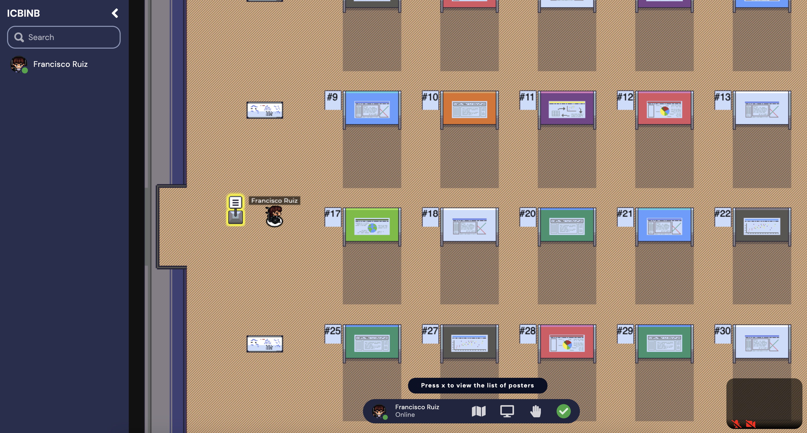
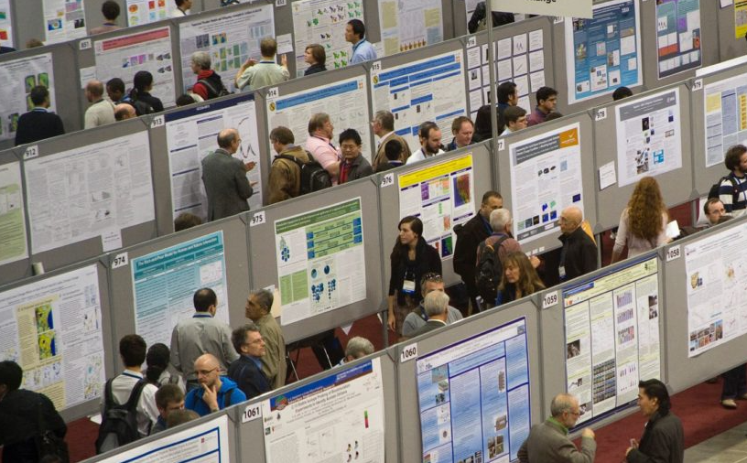
Poster sessions

Slide 9
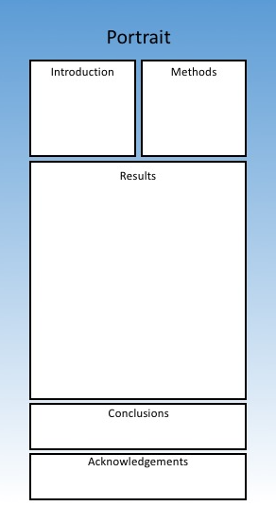
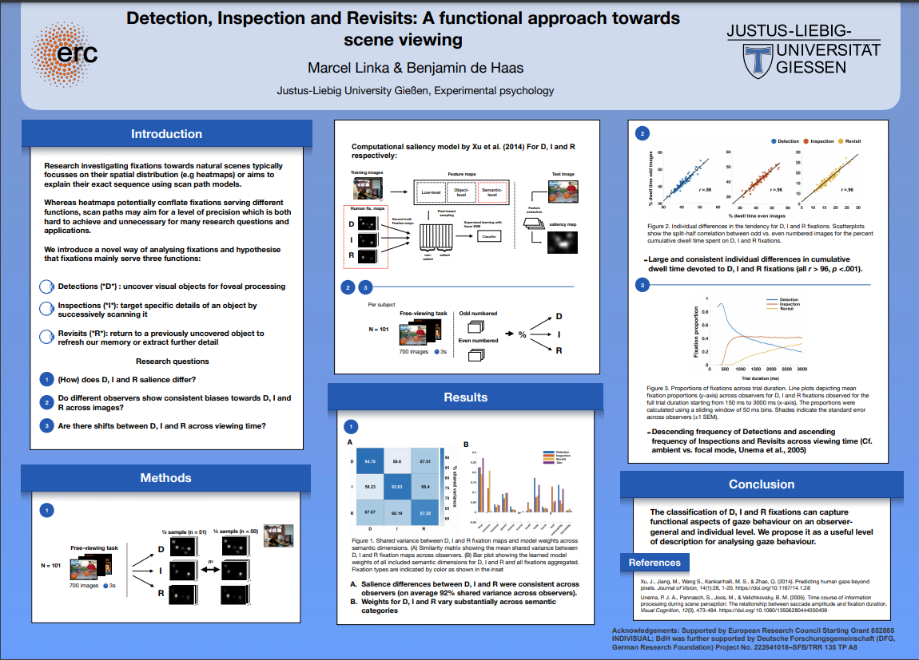
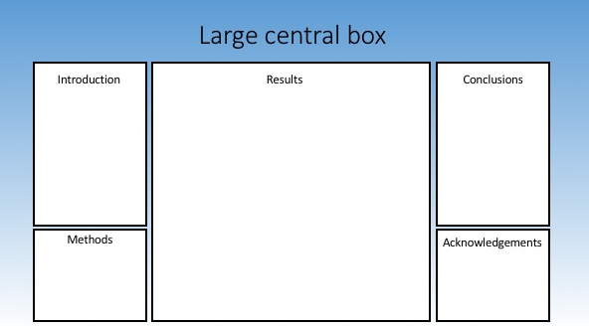
The basics
Content structure:
Introduction
Methods
Results
Conclusions
Acknowledgements,
references, contact
Graphical structure:
Check formatting instructions
Break up space
Follow natural flow
(top-bottom, left-right)
Large title
Graphics > text

Slide 10
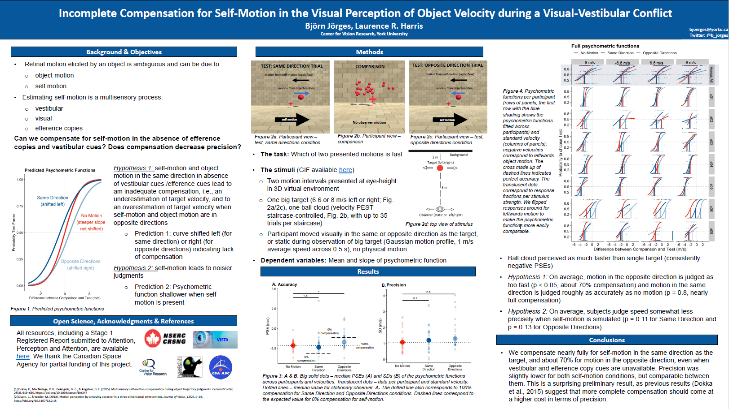
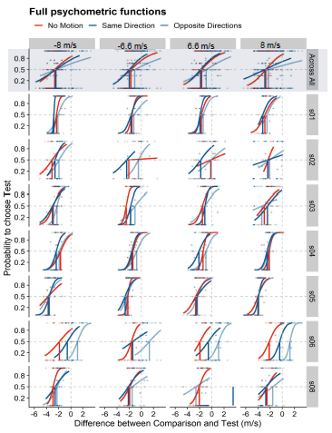
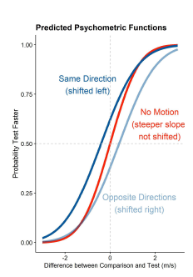
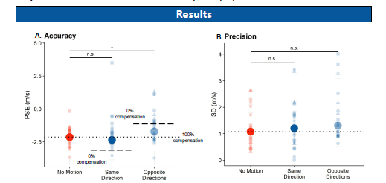
Some basics of graphic design
Color
Help convey your story
Accessibility

Slide 11
Some basics of graphic design
Scale and proportions:
Text-to-figure ratio
Large enough fonts
Whitespace
Simplicity

Slide 12
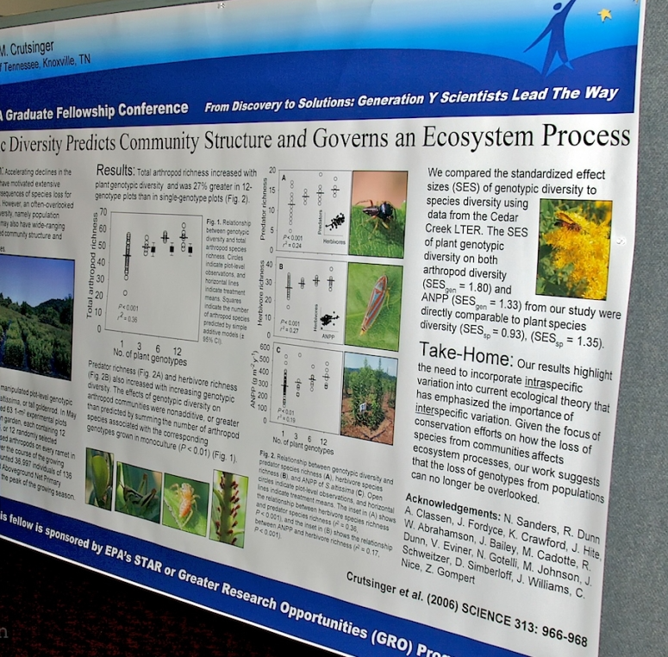
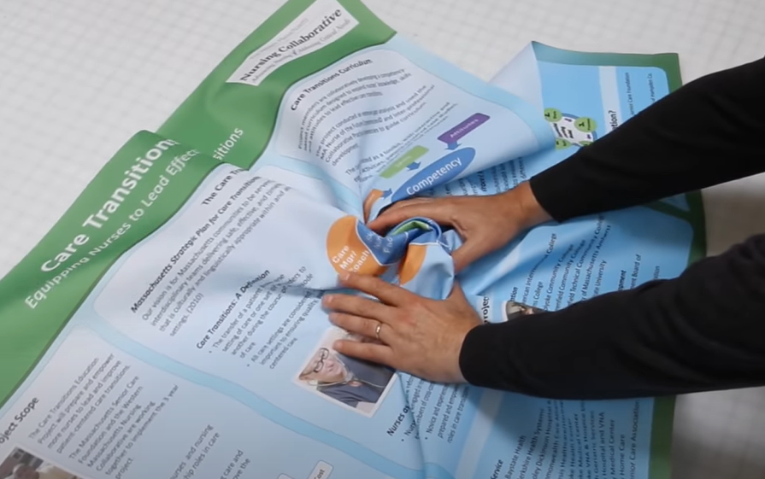
Practicalities
For the poster
PowerPoint
Google Slides
Adobe Illustrator
Markdown languages
For diagrams and illustrations:
Inkscape
Graphics databases:
https://biorender.com/
https://thenounproject.com/
Data graphics
R
Excel
Printing
Paper
Fabric
Transport

Slide 13
Presenting the poster
Be ready to walk visitors through your poster
2-5min full story
„elevator pitch“
practice

Slide 14
Questions?
Email: bjoerges@yorku.ca
Twitter: @b_jorges
Discord: Bjorn (he/el)#9677

Slide 15
https://blog.addgene.org/guide-to-designing-the-scientific-poster
https://www.calliechappell.com/blog/scientific-poster
Handout by Lana Mrkonja (Texas A&M University), see further materials in the GitHub repository: https://github.com/b-jorges/communicating-science

